Slide 1
Digital Marketing Conversion
Prediction

Slide 2
Steps :
Project Overview
Data Overview
Exploratory Data Analysis (EDA)
Power BI Dashboard
Feature Engineering
Challenges Faced
Model Training And Pipeline
Model Selection
Model Evaluation and Performance
Prediction Pipeline and UI
Conclusion And Next Steps

Slide 3
Project Overview
Predicting conversion rates of digital marketing campaigns based on features
The objective is to develop a robust machine learning model that predicts customer conversions based on various demographic and engagement features, enabling improved campaign targeting, increased conversion rates, and maximized return on advertising spend.

Slide 4
Data Overview
Data Source Link :
Total 20 features and 8000 rows.
There are 5 categorical feature and 15 numerical feature. One feature is dependent feature(‘Conversion’).
There are two value in ‘conversion’ column 0 and 1.
Customer conversion successful on marketing campaign that value is 1 if it goes unsucessfull that value is 0.
There are three use less feature that will be removed(CustomerID, AdvertisingPlatform, AdvertisingTool)

Slide 5
Exploratory Data Analysis
Objective of EDA: Understand the structure, distribution, and relationships within the data.
Identify patterns, trends, and outliers that can influence model performance.
Guide feature selection and preprocessing steps.
Distribution of Key Variables: Histograms or box plots of features like age, gender, etc.
Correlation Heatmap: Visual representation of correlations between different features.
At last we will see visullization of PowerBI datshbord.

Slide 6
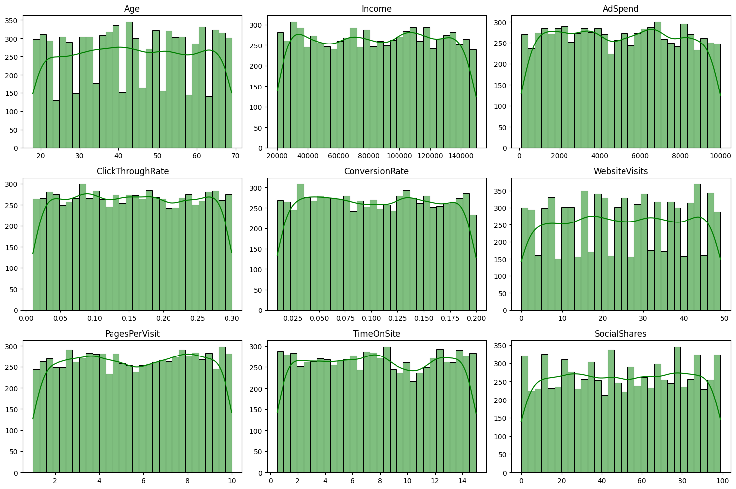
Age : The Age of customer is distributed in the range of 20 to 70
Income : The customers income is between $20000 to $14000
AdSpend : The distribution of advertising spend is relatively uniform, suggesting consistent marketing investments.
ConversionRate : This feature also shows a uniform distribution, implying varied but balanced customer responses to marketing efforts.
WebsiteVisits : The number of website visits suggests consistent browsing behavior, with users frequently visiting the site.
PagesPerVisit : This distribution indicates that users are engaging with multiple pages per session.
Conversion : The conversion rate distribution highlights a higher concentration of successful conversions, indicating effective marketing strategies.

Slide 7
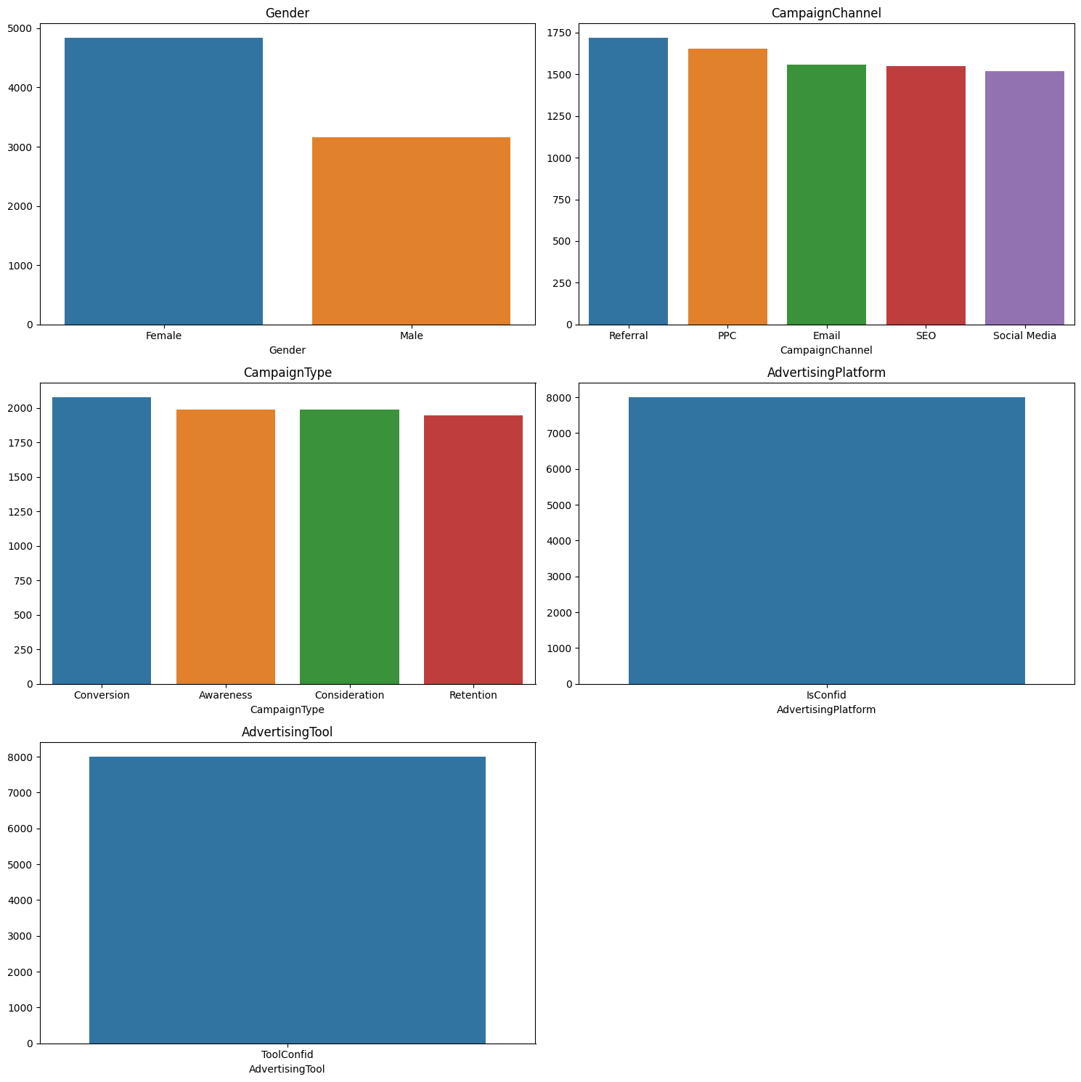
Gender : Incomeratively female customer is heigher than male customer.
Campaign Channel : There are four Campaing channel all are used in equally.
Campaing Type : ALL Campaign type are use in equally.
Advertising Platform: This Feature containes only one value 'IsConfid'. there is no another value thats why it's does't mean to take while Model Training
AdvertisingTool : This Feature containes only one value 'ToolConfid'. there is no another value thats why it's does't mean to take while Model Training

Slide 8
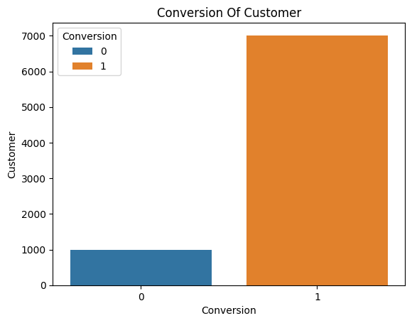
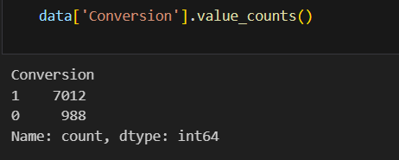
Here we can see the conversion rate of customer 7012 customer is conversion and 988 customer is not Conversion.
here we can face problem of data imbalance while training model.
Our model will be biased to 1 .
if we give a 0 conversion value to model for predict it will predict 1.

Slide 9
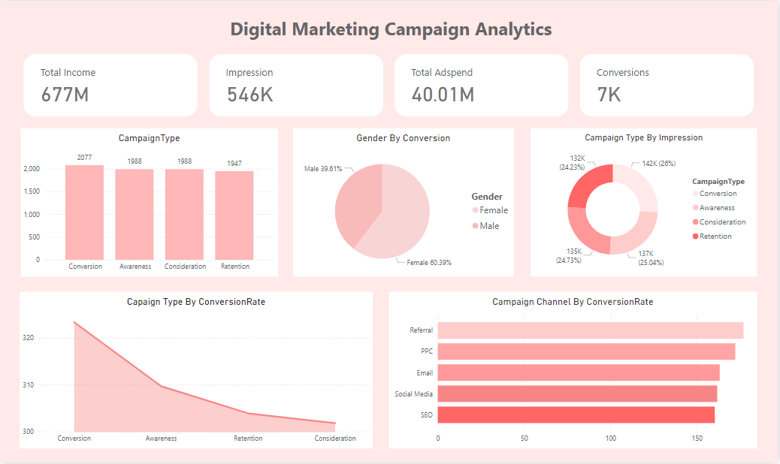
Dashboard

Slide 10
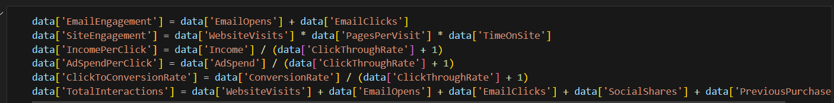
Feature Engineering
1. Email Engagement : Reflects overall engagement with email marketing by combining email opens and clicks.
2. Site Engagement : Evaluates website engagement using visits, pages per session, and average time spent.
3. Ad Spend Per Click : Assesses the cost-effectiveness of ad spending per click. Adding 1 to ClickThroughRate avoids divide-by-zero errors.
4. Click to Conversion Rate : Measures how efficiently clicks are converted into actual conversions. Adding 1 to ClickThroughRate avoids divide-by-zero errors.
5. Income Per Click : Calculates potential value generated per click based on income. Adding 1 to ClickThroughRate avoids divide-by-zero errors.
6. Total Interactions: Provides comprehensive measure of customer engagement by aggregating multiple interaction .

Slide 11
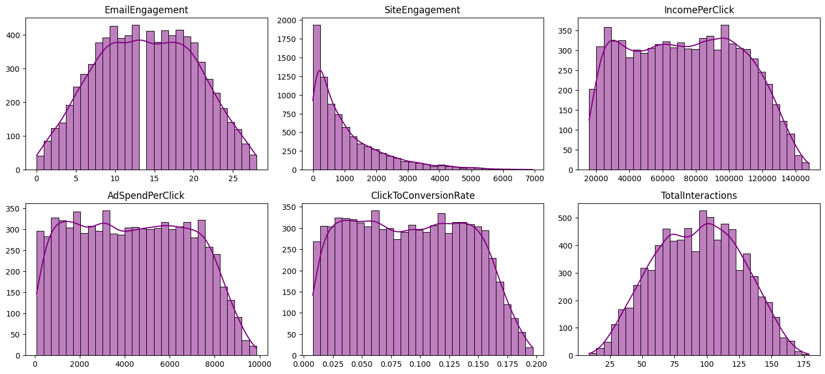
New Feature Engineering Columns
Email Engagement :
Nearly normal distribution with most users showing moderate engagement.
Site Engagement :
Highly right-skewed, with most users showing low engagement.
Income Per Click :
Normal distribution with consistent values across users.
Ad Spend Per Click :
Balanced, normal distribution indicating consistent ad performance.
Click to Conversion Rate :
Uniform distribution suggesting varied user behavior.
Total Interactions :
Bell-shaped curve, showing consistent engagement levels with few outliers.

Slide 12
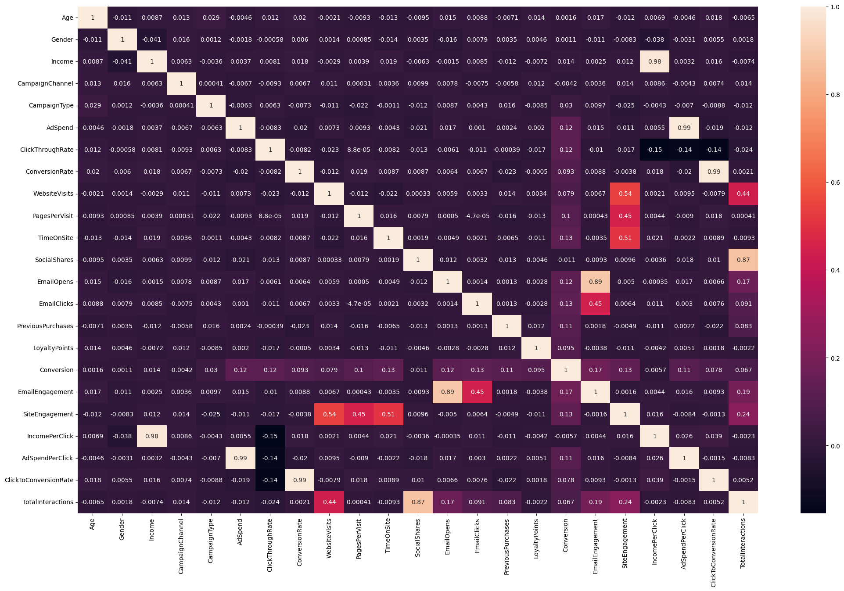
Heatmap After Feature Engineering

Slide 13
Correlation Matrix Insights
The correlation matrix provides a comprehensive view of the relationships between different features in the dataset. Below are the key observations:
High Correlation Due to Derived Features:
- Income and IncomePerClick : Strong positive correlation 0.98, indicating that higher income is directly associated with higher income per click. This high correlation is expected as IncomePerClick is derived from Income.
- AdSpendPerClick and Income : High positive correlation 0.99, suggesting that higher ad spend per click is closely related to higher income. This is also due to AdSpendPerClick being a derived feature.
- ConversionRate and ClickToConversionRate : Perfect positive correlation 0.99, indicating that these metrics are essentially measuring the same aspect of user behavior, which is expected since ClickToConversionRate is derived from ConversionRate. - SiteEngagement and TimeOnSite : Moderate positive correlation 0.53, suggesting that higher site engagement is associated with more time spent on the site.
- TotalInteractions and SocialShares : Moderate positive correlation 0.88 , indicating that total interactions increase with more social shares.
Low to No Correlation: Most other features have low or no significant correlation with each other, indicating a diverse set of variables that capture different aspects of customer behavior.

Slide 14
Challenges Faced
Data Imbalance Challenge
Initial Problem:
The dataset was highly imbalanced with two classes:
Class 1: 7012 row ,
Class 0: 988 rows
Risk of overfitting or bias towards Class 1 during model training.
Solution Approach :
1. Sampling Strategy:
Selected 988 rows from Class 1 to balance the dataset.
Issue: This approach might not capture all patterns of Class 1.
Resolution: Used Stratified Sampling to ensure all patterns of Class 1 were represented.
2. Data Augmentation with SMOTE:
To address the limitation of small sample size, applied SMOTE (Synthetic Minority Oversampling Technique).
Generated a balanced dataset with a total of 8000 rows:
Class 0: 4000 rows
Class 1: 4000 rows
Impact on Model Training:
Balanced data reduced the risk of bias and overfitting.
Augmentation provided sufficient data for the model to generalize better, improving its accuracy and robustness.

Slide 15
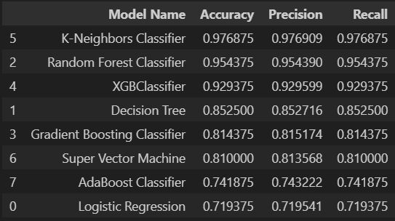
Model Selection
Logistic Regression: Simple Linear Classifier
Decision Tree: Rule-Based Tree Classifier
Random Forest Classifier: Ensemble Tree Classifier
Gradient Boosting Classifier: Boosted Decision Trees
XGBClassifier: Extreme Gradient Boosting (XGBoost)
K-Neighbors Classifier: Nearest Neighbors Classifier
Support Vector Machine (SVM): Margin-Based Classifier
AdaBoost Classifier: Adaptive Boosting Classifier

Slide 16
Model Evaluation And Performance
K-Neighbors Classifier is give heigh accuracy 97% than other models . There is a GridsearchCV used for get best Hyper-perameter for every model. Random Forest Classifier and XgboostClassifier perform good with accuracy 95 % and 92 %.
Observations:
- The model is better at predicting Class 1 (higher True Positive rate) than Class 0 (lower True Negative rate). - The model has a relatively low False Positive rate, indicating it is not likely to misclassify a Class 0 instance as Class 1. - The model has a moderate False Negative rate, suggesting it is not consistently accurate in identifying Class 1 instances.
- High AUC Score: The AUC (Area Under the Curve) of 0.9915 suggests excellent model performance in distinguishing between positive and negative cases.

Slide 17
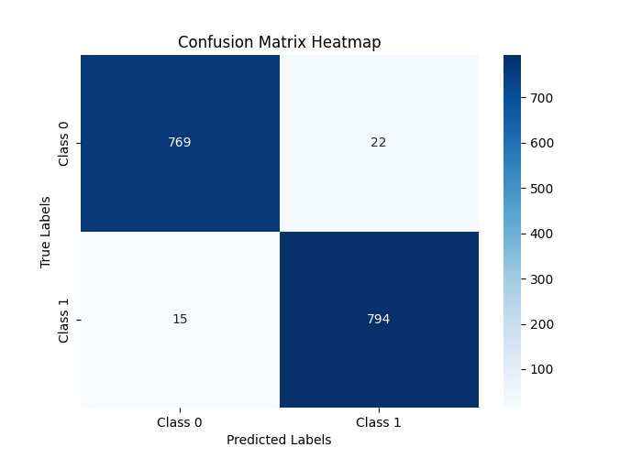
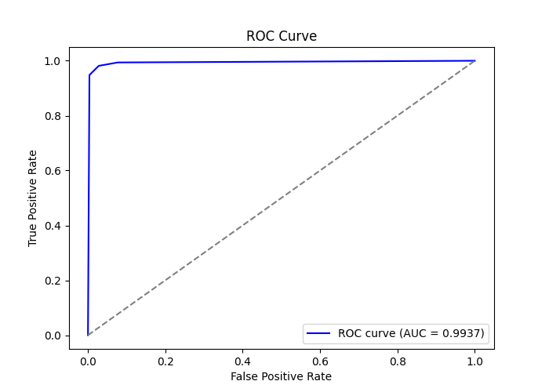
Evaluation Metrix
K-Neigbour Classifier

Slide 18
Prediction Pipeline and UI(User Interface)
Flask: A lightweight web framework used to build the application.
Web Pages:
Welcome Page:
Features a clean, user-friendly design.
Includes a "Predict Now" button that directs users to the prediction form.
Home Page (Prediction Page):
Contains a form where users can input values for the required features.
On clicking the "Submit" button, the value go into prediction pipeline .the model processes the input and provides the prediction result.
User Journey:
Users land on the Welcome Page and click "Predict Now."
Redirected to the Home Page where they input feature values.
Click "Submit" to view the prediction results in real time.

Slide 19
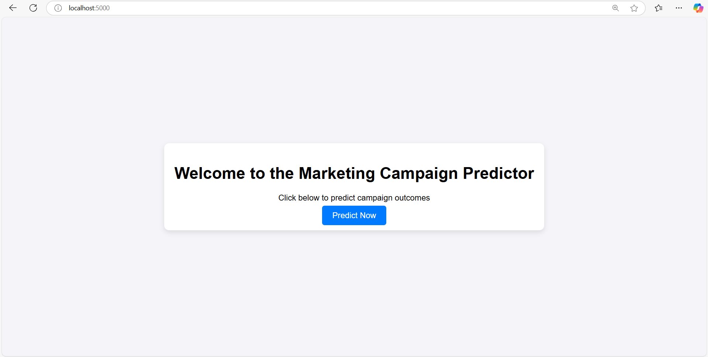
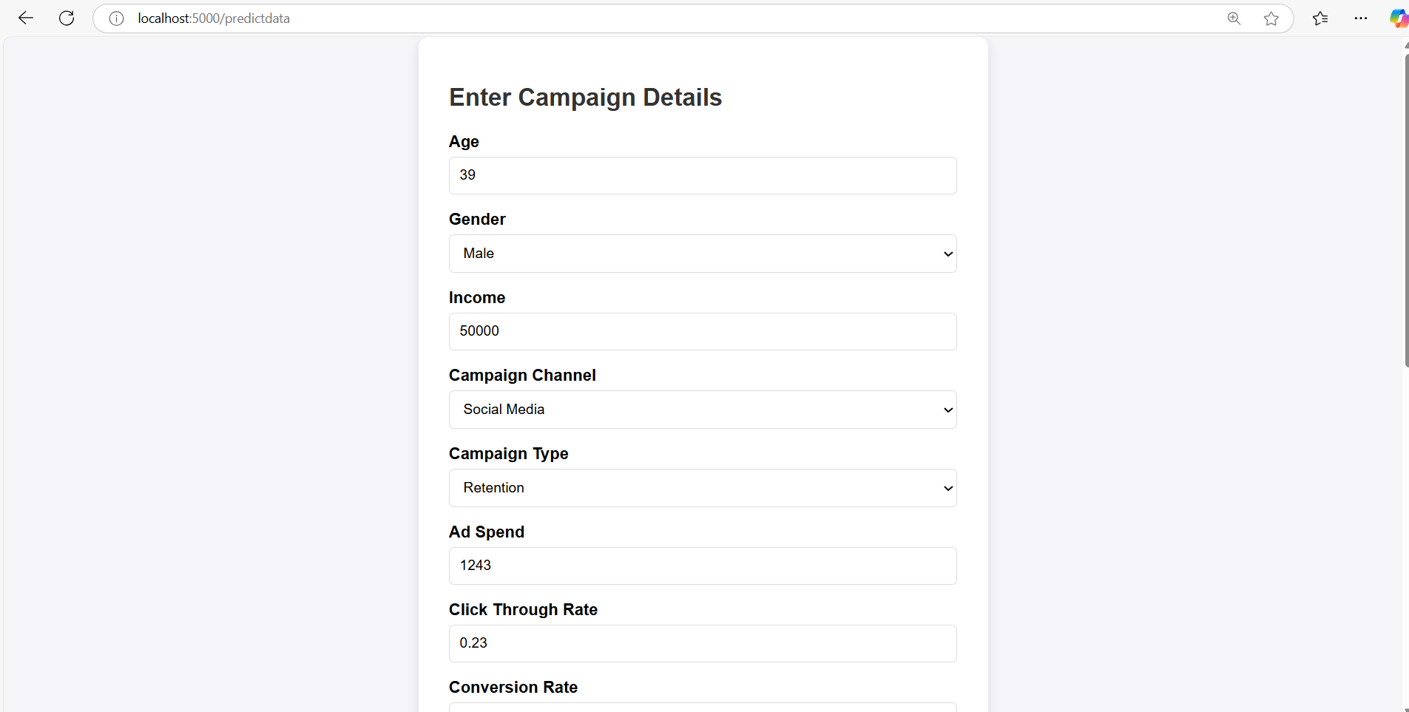
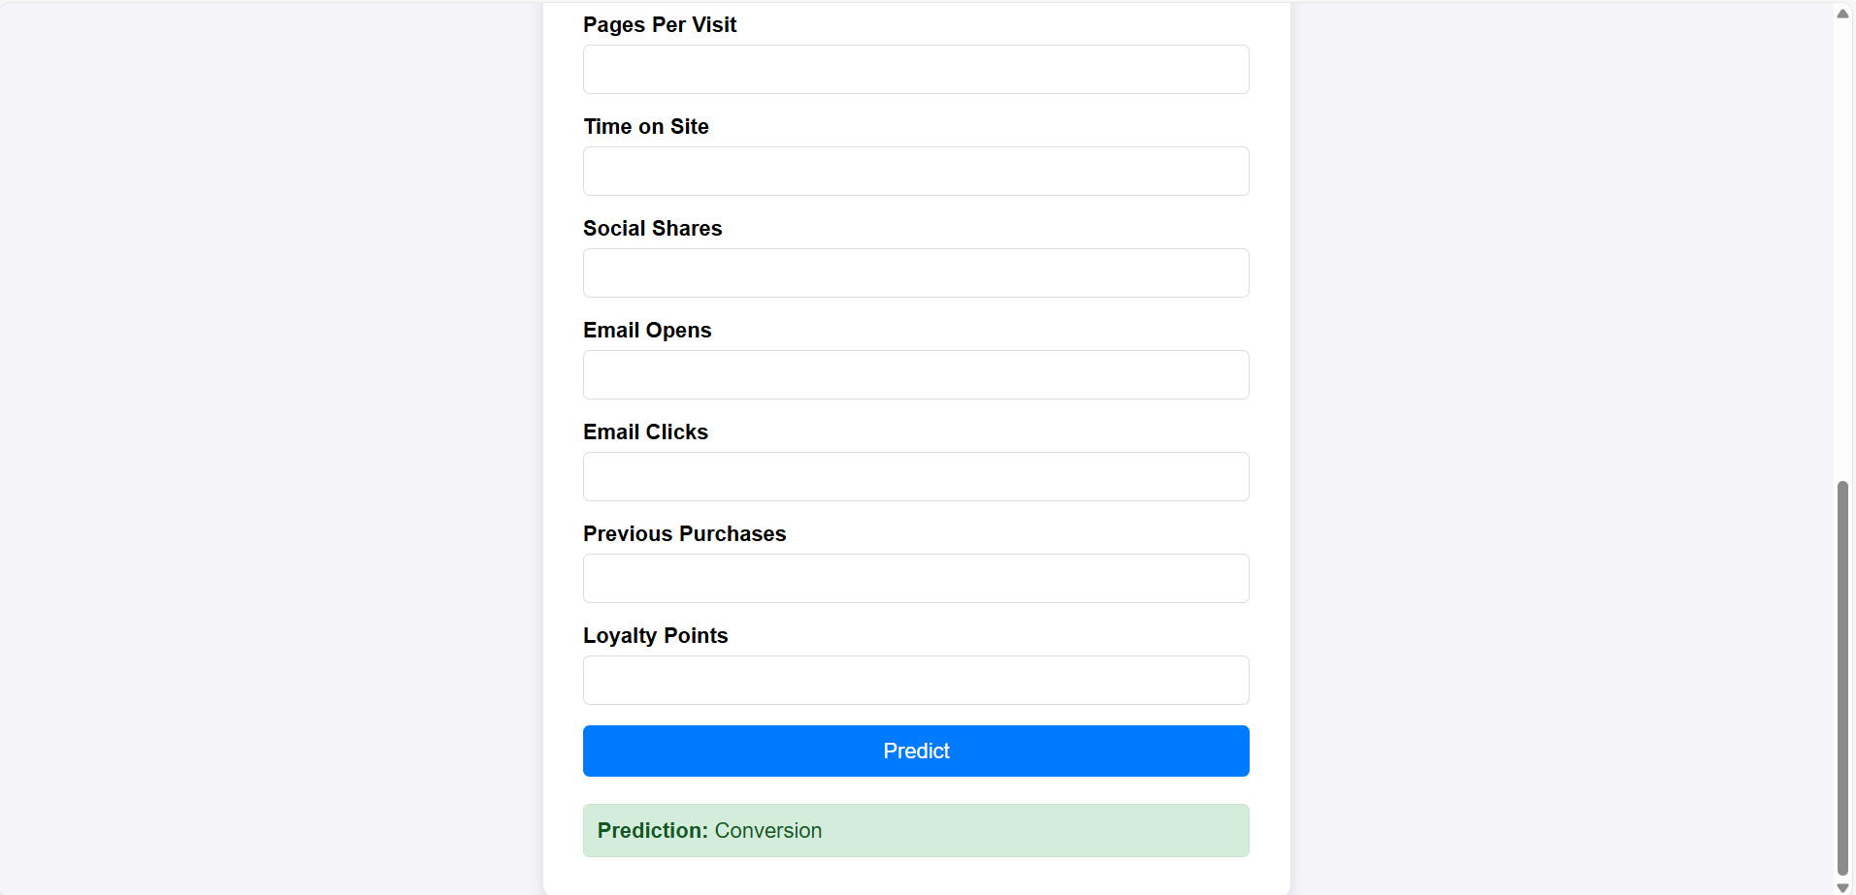

Slide 20
Conclusion
K-Neighbors performs the best overall with the highest accuracy (0.97) and balanced performance across both classes. It provides a good trade-off between precision and recall for both positive and negative classes.
Random Forest Classifier has high accuracy (0.95) with a 95 % precision and 95 % recall score.
XGBoostClassifier has high accuracy (0.92) with a 92 % precision and 92 % recall score.
Logistic Regression has the lowest accuracy (0.71) It is equal between precision and recall for both positive and negative classes.
In conclusion, K-Neighbors and Random Forest is the most well-rounded model in this comparison, showing the highest accuracy and a good balance in performance metrics across both classes. It is likely the best choice for next step. If we want to make a model more efficient model need more original data.

Slide 21
Thank You!

